Slide 1

Fire & Smoke Detection
Image Recognition Model

Slide 2
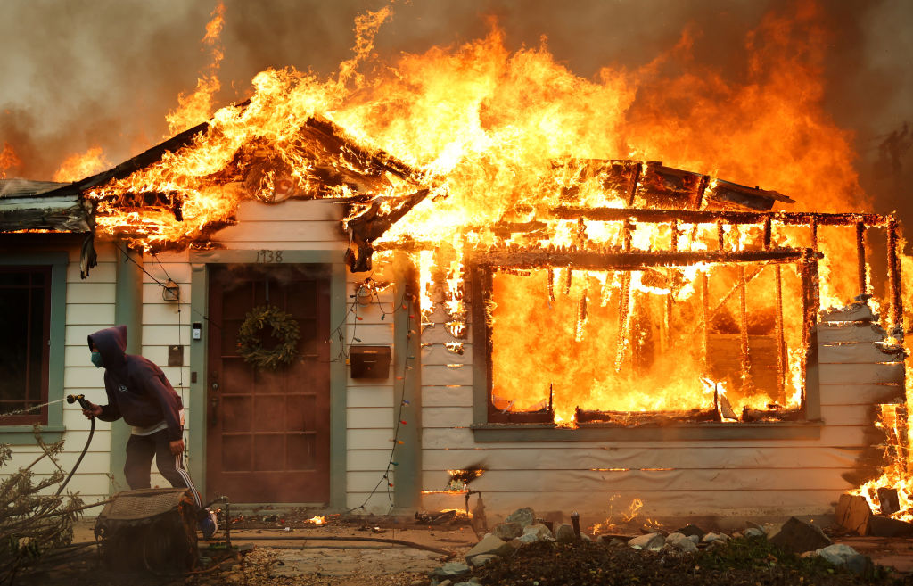
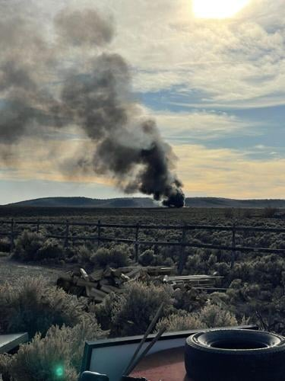

Fire
Neutral
Smoke
Data Collection and Labeling

Slide 3
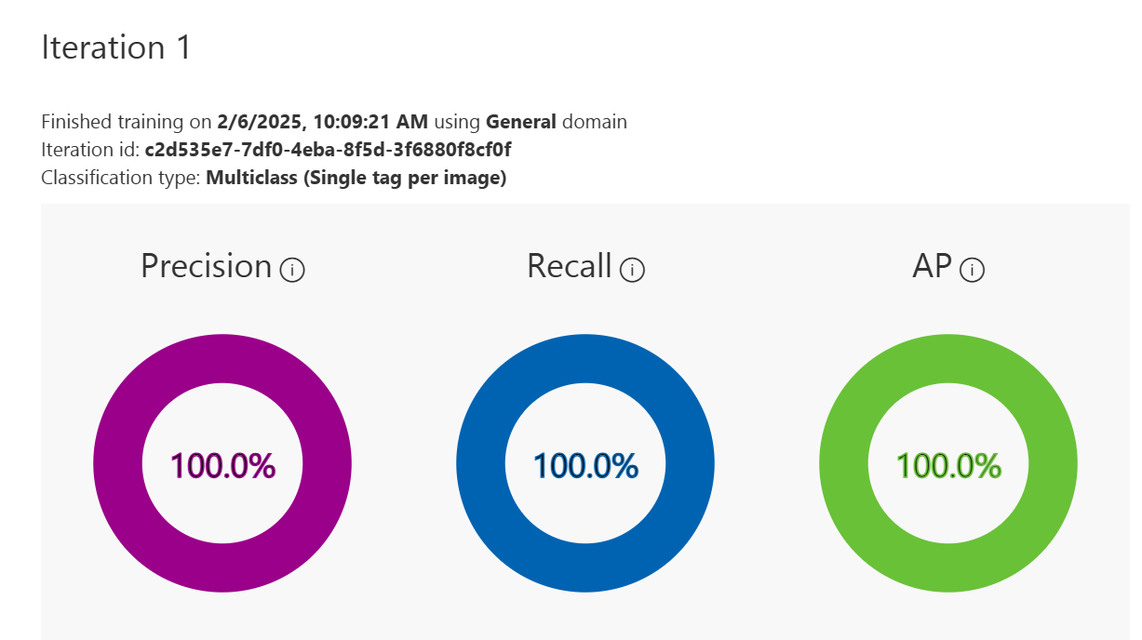
Model Training and Performance

Slide 4
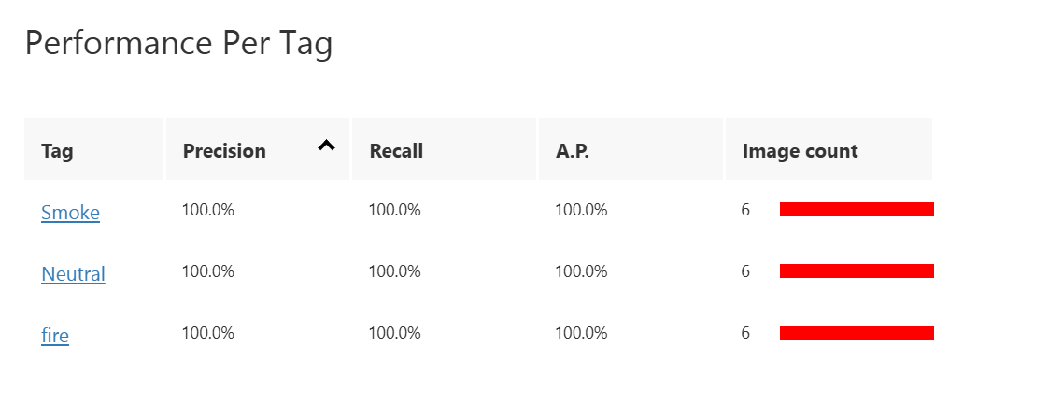
Model Training and Performance

Slide 5

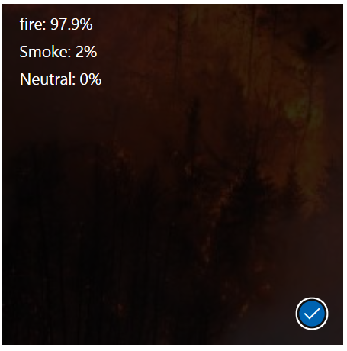
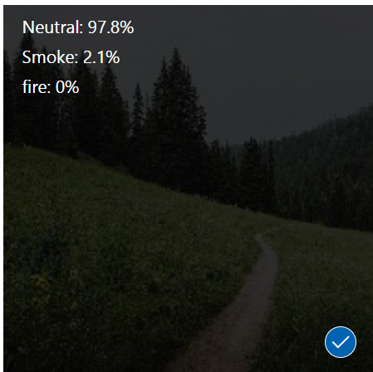
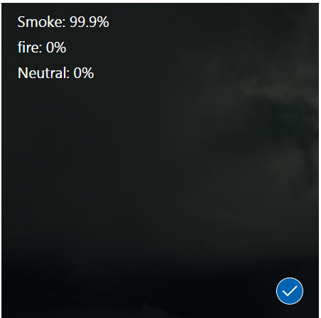


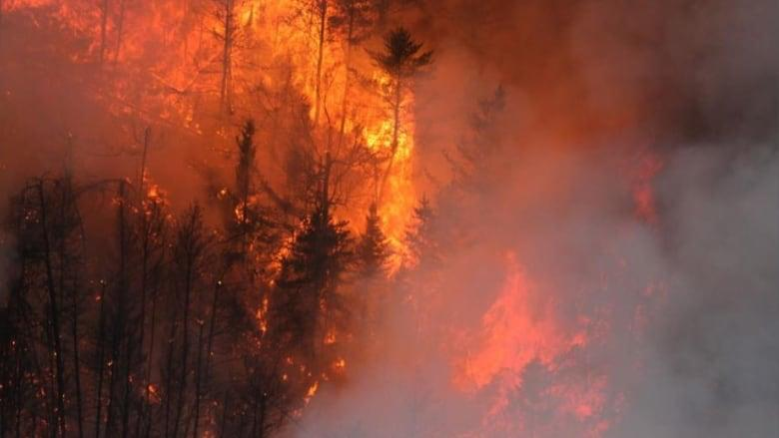
Testing the Model and Assessing the performance

Slide 6
Testing the Model and Assessing the performance
If the accuracy is low, we have to retrain the model by adding more images in data. However, our accuracy is more than 95% so there are no changes to be made, and we can deploy and publish the model.

Slide 7

Thank You
Presented by:
Shivam Kansara
Srinivas Bhootam
Om Patel
Rishu Dixit
Shashivadhan C.

